Slide 1

The Internet & the World Wide Web: Exploring Cyberspace
2
Chapter

Slide 2

Chapter 2 Topics
UNIT 2A: The Internet & the Web
2.1 Connecting to the Internet: Narrowband, Broadband, & Access Providers
2.2 How Does the Internet Work?
2.3 The World Wide Web
UNIT 2B: The Riches & Risks of Internet Use
2.4 Email, Instant Messaging & Other Ways of Communicating over the Net
2.5 The Online Gold Mine: Telephony, Multimedia, Webcasting, Blogs, E-Commerce, & Social Networking
2.6 The Intrusive Internet: Snooping, Spamming, Spoofing, Phishing, Pharming, Cookies, Spyware & Malware

Slide 3
UNIT 2A: The Internet & the Web
The Internet began in 1969 as ARPANET.
The Internet was text-only. In the early 1990s, multimedia became available on the Internet, and the World Wide Web (web) was born.

Slide 4

To connect to the Internet you need
1. An access device (computer with modem)
2. A means of connection (telephone line, cable hookup, or wireless)
3. An Internet access provider

Slide 5
2.1 Connecting to the Internet
Narrowband, Broadband,
& Access Providers

Slide 6

However you connect to the Internet, the bandwidth will determine the speed of your connection.
Bandwidth : Expresses how much data can be sent through a communications channel in a given amount of time.
Baseband: Slow type of connection that allows only one signal to be transmitted at a time.
Broadband: High-speed connections.

Slide 7
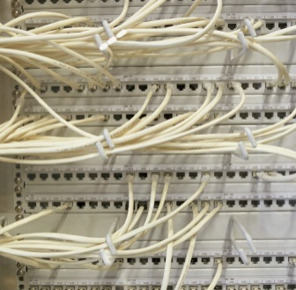


Physical connection to Internet—wired or wireless?
Telephone [dial-up] modem
High-speed phone line—DSL, T1/T3
Cable modem
Wireless—satellite and other through-the-air links (Wi-Fi, 3G, & 4G)
Internet Access Providers

Slide 8

Data Transmission Speeds
Originally measured in bits per second (bps)
8 bits are needed to send one character, such as A or a
Kbps connections send 1 thousand bits per second
Mbps connections send 1 million bits per second
Gbps connections send 1 billion bits per second
Uploading & Downloading
Upload—transmit data from local to remote computer
Download—transmit data from remote to local computer

Slide 9

Narrowband (Dial-Up Modem): Low speed but inexpensive
Telephone line = narrowband, or low bandwidth, low speed
Dial-up connection—use of telephone modem to connect to Internet (used mostly in rural areas on POTS, or plain old telephone system)
Telephone Modems
Can be either internal or external
Maximum speed of 56 Kbps
Most ISPs offer local access numbers

Slide 10
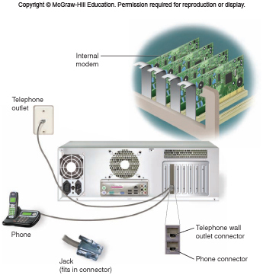
Telephone (Dial-Up) Modem
Panel 2.3
Page 55

Slide 11

High-Speed Lines
More expensive but available in cities & most towns
Digital Subscriber Line DSL
Uses regular phone lines, DSL modem
Receives data at 7 ̶ 105Mbps; sends at about 384 Kbps – 1 Mbps
Is always on
Need to live no farther than 4.5 miles from phone company switching office
Not always available in rural areas
T1 line—very expensive
Traditional trunk line, fiber optic or copper; carries 24 normal telephone circuits
Transmission rate of 1.5 ̶ 6 Mbps (T3 = 6 – 47 Mbps)
The “last mile” can still be a problem
Generally used by large organizations

Slide 12
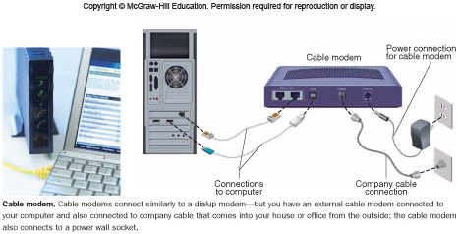
High-Speed Lines
Cable modem
TV cable system with Internet connection; company usually supplies cable modem
Is always on
Receives data at up to
100 Mbps; sends at
about 2-8 Mbps

Slide 13
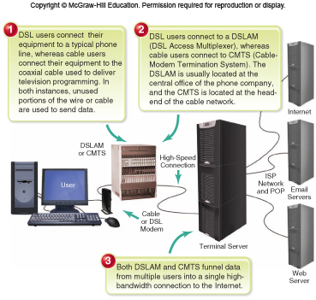
Basic DSL/Cable-PC system
Panel 2.4
Page 57

Slide 14

Satellite Wireless Connections
Transmits data between satellite dish
and satellite orbiting earth
Connection is always on
Requires Internet access provider with 2-way
satellite transmission
User needs to buy or lease satellite dish and
modem and have them connected

Slide 15

Other Wireless: Wi-Fi, 3G, & 4G
Wi-Fi—stands for “wireless fidelity”
Name for a set of wireless standards (802.11) set by IEEE
Transmits data wirelessly up to 54 Mbps for 300 – 500 feet from access point (hotspot)
Typically used with laptops and tablets that have Wi-Fi hardware
3G = “third generation”; uses existing cellphone system; handles voice, email, multimedia
4G = “fourth generation”; faster than 3G; built specifically for Internet traffic – but not standard yet
Both 3G and 4G used mostly in smartphones

Slide 16
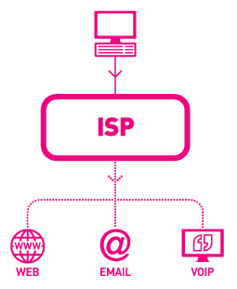
Internet Access Providers (ISPs)
Internet Service Provider ISP : Local, regional, or national organization that provides access to the Internet for a fee — e.g., Comcast, Charter, AT&T.
Wireless Internet Service Provider (WISP) — e.g., AT&T, T-Mobile, Verizon Wireless, Sprint, Credo
Enables wireless-equipped laptop/tablet and smartphone users to access Internet

Slide 17
2.2 How Does The Internet Work
The Internet is basically a huge network that connects hundreds of thousands of smaller networks.

Slide 18
Internet Connections: POPs, IXPs, Backbone, & Internet2
point of presence (POP) — a local access point to the Internet—a collection of modems and other equipment in a
Internet Exchange Point (IXP), a routing computer at a point on the Internet where several connections come together.
Internet backbone, high-speed, highcapacity transmission lines, usually fiber-optic lines, that use the newest communications technology to transmit data across the Internet.
Internet2 is a not-for-profit cooperative university/business education and research project that enables high-end users to quickly and reliably move huge amounts of data over high-speed networks.

Slide 19
Who Runs the Internet?
the Internet Corporation for Assigned Names and Numbers (ICANN), was established to regulate human-friendly Internet domain names—those addresses ending with .com, .org, .net, and so on, that overlie IP addresses and identify the website type

Slide 20
IP ADDRESS
An Internet Protocol (IP) address uniquely identifies each computer and device connected to the Internet.
An IP address consists of four sets of numbers between 0 and 255 separated by decimals (called a dotted quad )— for example, 1.160.10.240.
There are two types of IP addresses, dynamic and static.

Slide 21
2.3 The World Wide Web

Slide 22





The Face of the Web: Browsers, Websites, & Web Pages
The World Wide Web brought multimedia to the Internet.
The web and the Internet are not the same; the web is multimedia-based, and the Internet is not. The Internet is the infrastructure that supports the web.
A browser is software that gets you to websites and their individual web pages and displays the content in such a way that the content appears mostly the same regardless of the computer, operating system, and display monitor.
Examples = Internet Explorer
Mozilla FireFox
Apple Macintosh’s Safari
Google’s Chrome
Microsoft’s Bing

Slide 23

Website
The location on a particular computer (server) that has a unique address; example = www.barnesandnoble.com, www.mcgraw-hill.com
The website (server) could be anywhere — not necessarily at company headquarters
Web Page
A document on the web that can include text, pictures, sound, and video
The first page on a website is the Home page
The Home page contains links to other pages on the website (and often other websites)

Slide 24
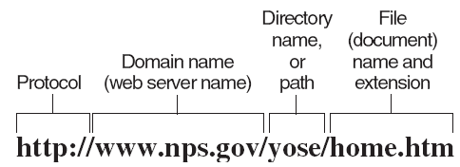
How the Browser Finds Thing: URLs
Uniform Resource Locator (URL): address for a web page
A character string that points to a specific piece of information anywhere on the web
A website’s unique address
It consists of
The web protocol, http://
The domain name of the web server
The directory name or folder on that server
The file within the directory, including optional extension

Slide 25
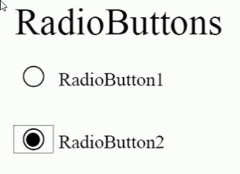
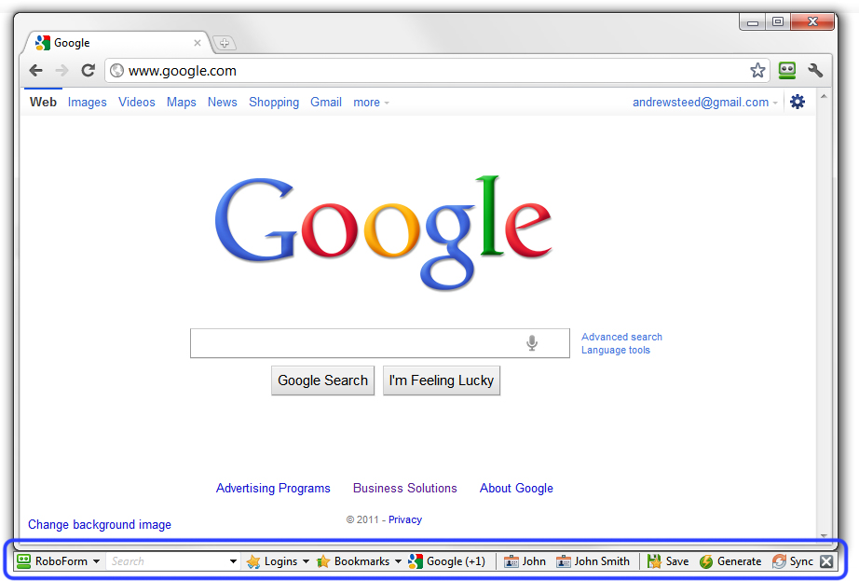
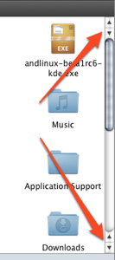
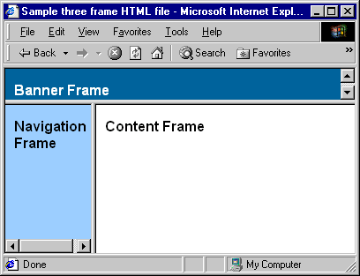
Interactivity with a web page
Click on hyperlinks to transfer to another page
Click on a radio button to choose an option
Type text in a text box
and then hit Enter
Click on scroll arrows to move up and down,
or side to side, on a page
Click on different frames
(separate controllable
sections of a web page)

Slide 26
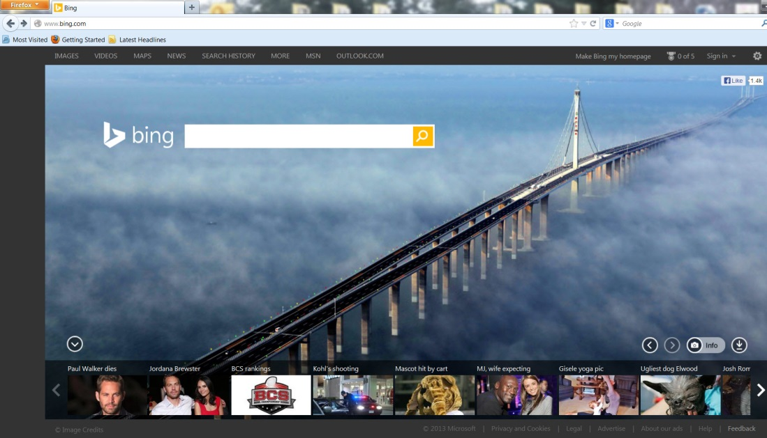
Web portals: Starting points for finding information
A portal is gateway website that offers a broad array of resources and services, online shopping malls, email support, community forums, stock quotes, travel info, and others. Ex. IUG student portal
Examples: Yahoo!, Google, Bing, Lycos, and AOL
Most require you to log in, so you can
Check the Home page for general information
Use the subject guide to find a topic you want
Use a keyword to search for a topic

Slide 27

Search Services & Search Engines
Organizations that maintain databases accessible through websites to help you find information on the internet
Examples: portals like Yahoo! and Bing, plus Google, Ask.com, Gigablast
Search services maintain search engines—programs that users can use to ask questions or use keywords to find information
Databases of search engines are compiled using software programs called spiders (crawler, bots, agents)
Spiders crawl through the World Wide Web
Follow links from one page to another
Index the words on that site
A search never covers the entire web
Search engines differ in what they cover

Slide 28

Four Web Search Tools
1. Individual Search Engines
Compile their own searchable databases on the web
You search by typing keywords and receiving “hits”
Examples are Ask, Bing, Google, and Yahoo!
2. Subject Directories
Created and maintained by human editors, not electronic spiders
Allow you to search for information by selecting lists of categories or topics
Example sites are Beaucoup!, LookSmart, Open Directory Project, and Yahoo! Directory
(continued)

Slide 29

3. Metasearch Engines
Allows you to search several search engines simultaneously
Examples are Yippy!, Dogpile, Mamma, MetaCrawler, and Webcrawler
4. Specialized Search Engines
Help locate specialized subject matter, such as info on movies, health, jobs
Examples are Career.com. WebMD, Expedia

Slide 30

Smart Searching: Three General Strategies
If you’re just browsing . . .
Try a subject directory
Next try a metasearch engine
If you’re looking for specific information . . .
Try a Answers.com “one-click” search
Or go to a general search engine, then a specialized one
If you’re looking for everything on a subject . . .
Try the same search on several search engines

Slide 31

Wikis & Wikipedia
A wiki is a simple piece of software that can be downloaded for free and used to make a website (also called a wiki) that can be corrected or added to by anyone.
Wikipedia is a free online encyclopedia that anyone around the world can contribute to or edit. It has more than 25 million articles in more than 285 languages; over 4.1 million articles appear in the English Wikipedia alone. However, Wikipedia is not considered reliable or authoritative by many academics and librarians.

Slide 32
Multimedia Search Tools
Still images—e.g., Google Image Search, Bing Images, Fagan Finder
Audio—e.g., Yahoo! Music, Lycos MP3 Search
Video—e.g., AlltheWeb, AOL.video
Scholarly—e.g., Google Scholar

Slide 33

Tagging
Tags: Do-it-yourself labels that people can put on anything found on the Internet, from articles to photos to videos, that help them to find their favorite sites again and to link them.
Can be shared easily with other people
Tags are commonly used on blogs and YouTube – word listed at the bottom. Essentially tags are keywords used to classify content. (The # is a hash symbol; thus the Twitter term hashtag. )

Slide 34
2.4 Email, Instant Messaging, & Other Ways of Communicating over the Net

Slide 35

Two ways to send & receive email:
1. Email Program
Enables you to send email by running email software on your computer that interacts with an email server at your Internet access provider
Incoming mail is stored on the server in an electronic mailbox
Upon access (your ID and password), mail is sent to your software’s inbox
Examples: Microsoft Outlook, Apple Mail
2. Web-Based Email
You send and receive messages by interacting via a browser with a website
Advantage: You can easily send and receive messages while traveling, using any computer or equipped mobile device
Examples: Yahoo! Mail and Gmail (Google)
Disadvantages are ads and email hacking

Slide 36
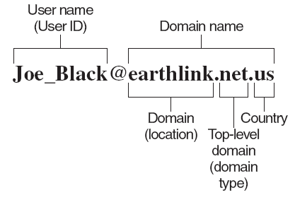
Using email
Get an email address from your ISP, following this format:

Slide 37

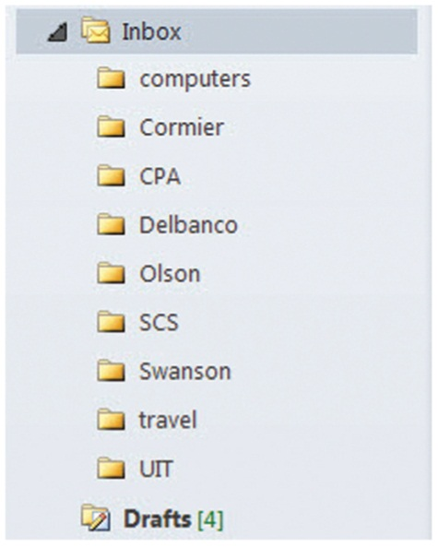
Tips for Using Email
1. Use the address-book feature to
store email addresses
2. Use folders to organize email
3. Be careful with attachments
4. Be aware of email netiquette

Slide 38

Email Attachments
A copy of a file or document that you send attached to an email to one or more people
Recipients must have compatible software to open the attachment; for example, if they don’t have Excel, they probably can’t read the spreadsheet you sent them.
Be careful about opening attachments:
Many viruses hide in them; scan them with antivirus software
Know who has sent the attachment before you open it

Slide 39

Netiquette: Appropriate Online Behavior
Don’t waste people’s time.
Don’t write anything that you would not say to a person’s face.
Include helpful subject and signature lines.
Be clear and concise.
Avoid spelling and grammatical errors.
Avoid SHOUTING and flaming.
Also:
Be careful with jokes.
Avoid sloppiness, but avoid criticizing other’s sloppiness.
Don’t send huge file attachments unless requested.
When replying, quote only the relevant portion.
Don’t overforward (don’t copy emails to everyone you know).

Slide 40
2.5 The Online Gold Mine
Telephony, Multimedia, Webcasting, Blogs, E-Commerce, & Social Networking

Slide 41
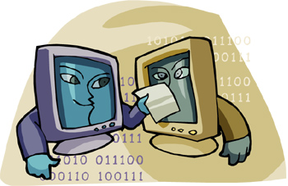
Telephony: The Internet Telephone
Uses the Internet to make phone calls via VoIP (Voice over Internet Protocol)
Long-distance calls are either very inexpensive or free
With no PC, dial a special phone number to packetize your call for a standard telephone
Use with a PC that has a sound card, microphone, Internet connection with modem & ISP, and internet telephone software such as Skype and Vonage
Also allows videoconferencing

Slide 42

Multimedia on the Web
Allows you to get images, sound, video, and animation
May require a plug-in, player, or viewer
A downloadable program that adds a specific feature to a browser so it can view certain files
Examples: Flash, RealPlayer, QuickTime
Multimedia Applets
Small programs that can be quickly downloaded and run by most browsers
Java is the most common Applet language
Text & Images: great variety available
Example: Google Earth
(continued)

Slide 43


Animation
The rapid sequencing of still images to create the appearance of motion
Used in video games and web images that seem to move, such as banners
Video & Audio
Downloaded completely before the file can be played, or
Downloaded as streaming video/audio
Examples: RealVideo and RealAudio

Slide 44
2.6 The Intrusive Internet
Snooping, Spamming, Spoofing, Phishing, Pharming, Cookies, Spyware, & Malware

Slide 45

Snooping
Snooping
Email is not private
Corporate management has the
right to view employees’ email.
Friends can send email anywhere.
Not all ISPs protect their customers’ privacy.
Deleted emails can be retrieved from a hard disk.

Slide 46
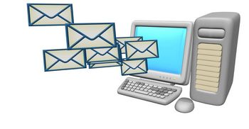
Spam
Spam: Electronic Junk Mail
Unwanted email that takes up your time.
Delete it without opening the message.
Never reply to a spam message.
Do not click on “unsubscribe” at the bottom of an email.
When you sign up for something, don’t give your email address.
Use spam filters.
Fight back by reporting new spammers to www.abuse.net or www.spamhaus.org.

Slide 47

Spoofing, Phishing, Pharming
Spoofing
Using fake email sender names so the message appears to be from a
different source, so you will trust it.
If you don’t know the sender, don’t open it.
Phishing
Sending forged email directing recipient to fake website.
Purpose: to attract people to share personal or financial data.
Fake website looks like real website, such as a bank’s.
Pharming
Implanting malicious software on a victim’s computer that redirects the user to an impostor web page even when the individual types the correct address into his or her browser.
Use websites with URLs that begin with https://
Some spyware removal programs can correct the corruption.

Slide 48
Cookies, Spyware, Malware
Cookies are little text files—such as your username, password, and preferences—left on your hard disk by websites you visit. The websites retrieve the data when you visit again.
Spyware is deceptive software that is surreptitiously installed on a computer via the web; once installed on your hard disk, it allows outsiders to gather confidential information without your knowledge.
There are many forms of malicious software—so-called malware— that can harm a computer system, a common danger being viruses.

Slide 49
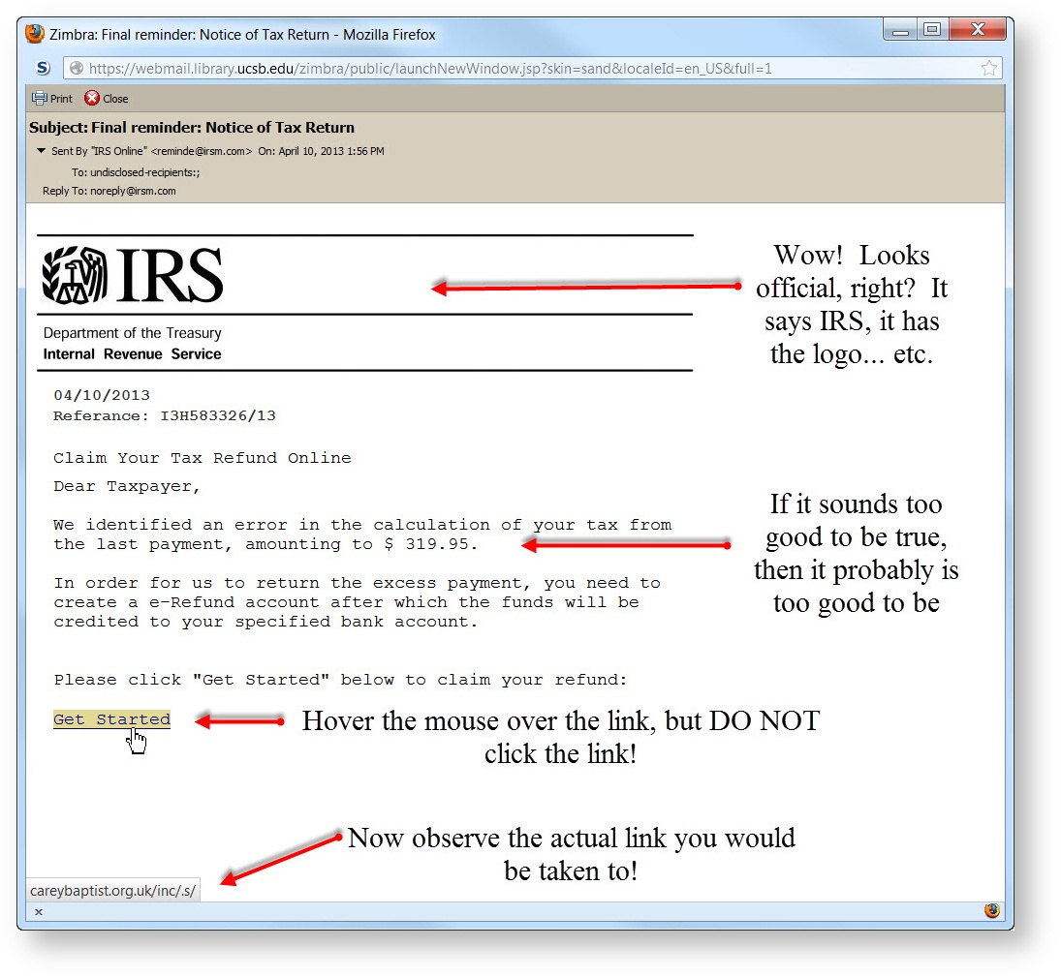
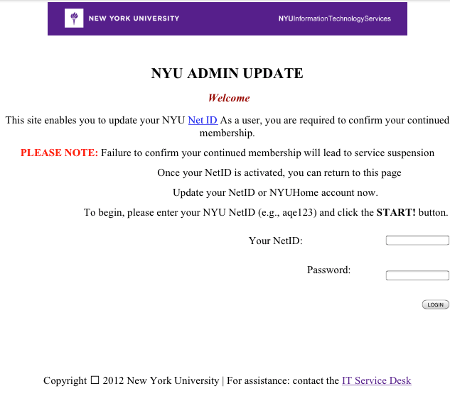
Phishing Examples
Phishing examples
"YOUR NET ID ACCOUNT" Phishing Scam (3/31/2013)
https://wiki.library.ucsb.edu/display/SYSPUB/Latest+Phishing+Attempts

Slide 50
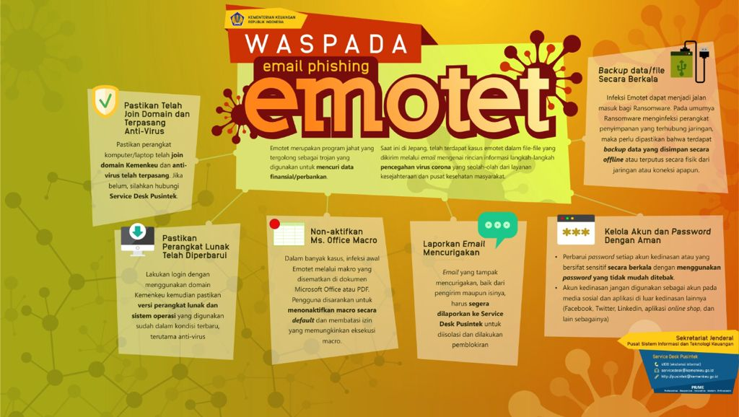

Slide 51
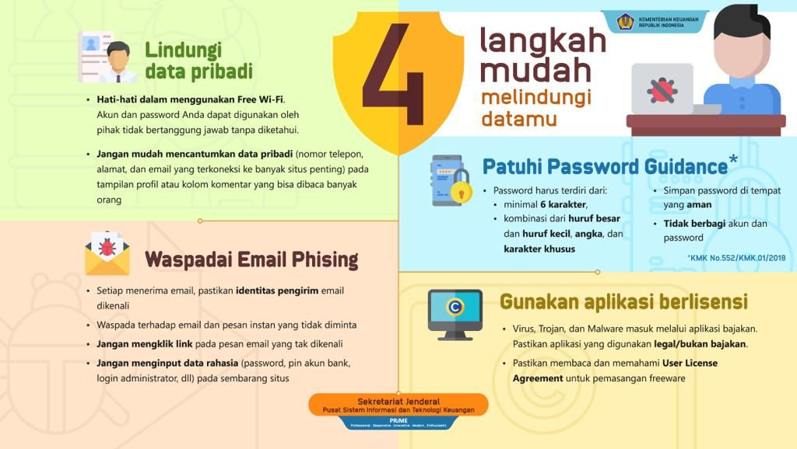

Slide 52
Peraturan pendukung
UU ITE No 11 Tahun 2008
UU No. 19 Tahun 2016. Perubahan Atas Undang-Undang Nomor 11 Tahun 2008 Tentang Informasi Dan Transaksi Elektronik
SE-14/MK.1/2017 Tentang Pencegahan dan Penanganan Ancaman Malware Khususnya Ransomware Jenis "Wannacry"
SE-26/MK.1/2017 Tentang Pencegahan Terhadap Ancaman Malware Jenis "Mamba" dan "Locky"
SE-22/MK.1/2017 Tentang Pencegahan dan Penanganan Ancaman Malware Jenis "Petya"
SE-33/MK.1/2014 Pengelolaan dan Penggunaan Surat Elektronik Resmi di Lingkungan Kementerian Keuangan
KMK-552/KMK.01/2018 Tentang Penggunaan Akun dan Kata Sandi, Surat Elektronik, Intranet dan Internet di Lingkungan Kementerian Keuangan

